Slide 1
English 7-Chapter 8
Exercise 7
Combining Sentences by Forming A Compound Sentence

Slide 2
1
Some Pueblos built villages in the valleys. Others settled in desert and mountain areas.
Some Pueblos built villages in the valleys, but others settled in desert and mountain areas.

Slide 3
2
Desert surrounded many of the valleys. The people grew crops with the help of irrigation systems.
Desert surrounded many of the valleys, and the people grew crops with the help of irrigation systems.

Slide 4
3
Women gathered berries and other food. Men hunted game.
Women gathered berries and other food, but men hunted game.

Slide 5
4
Their adobe homes had several stories. The people used ladders to reach the upper levels.
Their adobe homes had several stories, and the people used ladders to reach the upper levels.

Slide 6
5
Today each Pueblo village has its own government. The Pueblo people still share many customs.
Today each Pueblo village has its own government, but the Pueblo people still share many customs.

Slide 7
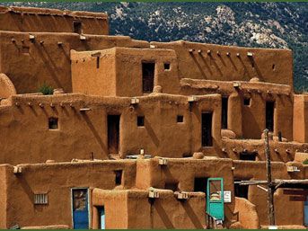
End

